Slide 1



Finding a Missing Element in a Sorted Matrix using Decrease and Conquer
BOOMADEVI S
23ITR016
JAIHARI D (19ITR028)

Slide 2

A library stores its book IDs in an n x n matrix.
The matrix is sorted in increasing order across each row and each column. Filled with unique IDs from 1 to n², but one ID is missing due to data loss.
The task is to find the missing book ID using an efficient algorithm that works in O(n) time.

Slide 3
Algorithm Design Technique
Decrease and Conquer
Reducing the size of the problem step by step
Solving a smaller version at each step
Repeating until the answer is found
Advantages of Using Decrease and Conquer in Problem:
Simple Approach: check one ID at a time, making the problem easy to solve step-by-step.
Efficient: O(n) time complexity.
Low Memory Usage: don't need extra memory or complex data structures, just the matrix and a counter for the expected ID.
Clear Progress: With each step, making progress toward finding the missing ID.
3

Slide 4
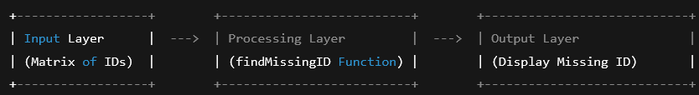
Algorithm: Find Missing ID in Matrix
Start with expected ID = 1 (IDs begin at 1).
Go through each element in the matrix:
Compare the current element with the expected ID.
If they don’t match, the expected ID is missing, so return it.
If they match, move to the next expected ID.
If no missing ID is found, return -1 (all IDs are present).

Slide 5
PSEUDOCODE
Function findMissingID(matrix):
Set rows to the number of rows in matrix
Set cols to the number of columns in matrix
Set expected to 1 (Assuming IDs start from 1)
For each row i from 0 to rows - 1:
For each column j from 0 to cols - 1:
If matrix[i][j] is not equal to expected:
Return expected (Found the missing ID)
Increment expected by 1
Return -1 (No missing ID found)
Main:
Initialize matrix with values:
[
[1, 2, 3],
[4, 5, 7], // Missing ID is 6
[8, 9, 10]
]
Set missingID to the result of findMissingID(matrix)
If missingID is not -1:
Print "Missing ID is: " + missingID
Else:
Print "No ID is missing."

Slide 6
Decide On Appropriate DataStructure
Data Structure:
Type: 2D Array (Matrix)
Purpose: To store book IDs in a sorted grid (row-wise and column-wise)
Input Size:
Matrix of size n x n
Total elements = n² - 1 (since one ID is missing)
Efficiency Class:
Time Complexity: O(n)
Space Complexity: O(1) (no extra space used)
6

Slide 7
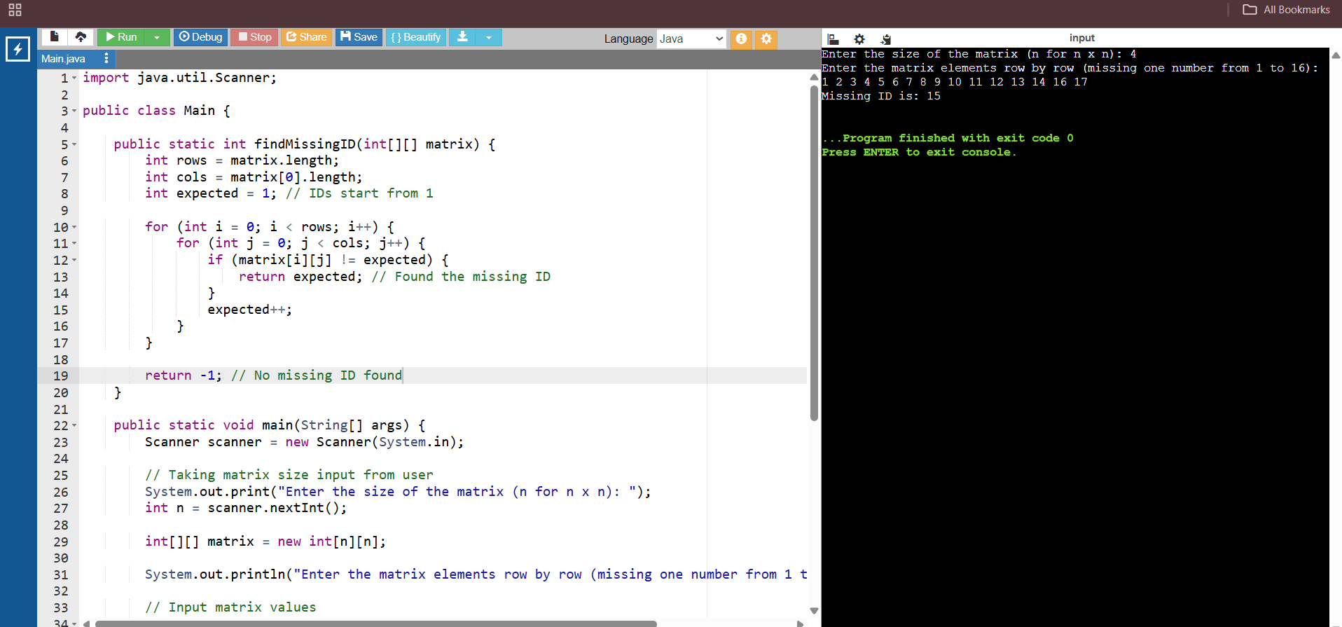
SAMPLE CODE
7

Slide 8
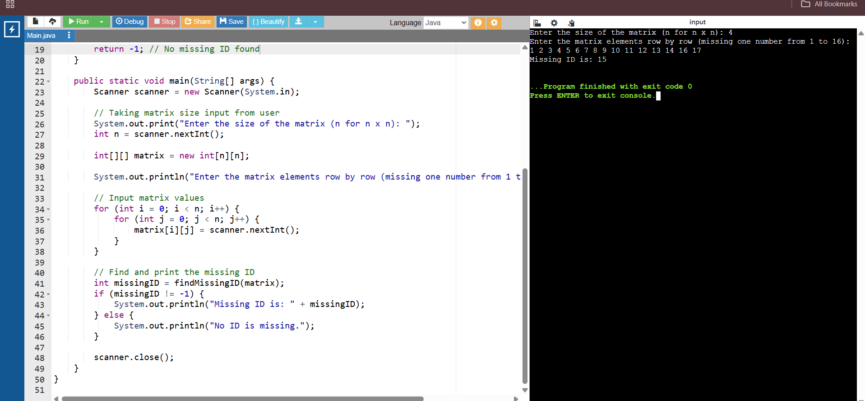
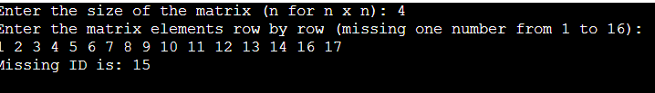

Slide 9
Thank you!

